Slide 1

Introduction to MS Excel
Basic Microsoft Office Programs
Lecture 1

Slide 2
Introduction
MS Excel is a commonly used Microsoft Office application. It is a spreadsheet program which is used to save and analyse numerical data.
In this course, we bring to you the important features of MS Excel, along with an overview of how to use the program, its benefits and other important elements.

Slide 3
Quick Access Toolbar
The Quick Access Toolbar is located all the way to the left on the Title Bar. It contains frequently used commands and can be customized using the drop-down menu:
1. Point to each small icon to view its ScreenTip.
2. Be aware that the Undo and Repeat buttons commands are not located anywhere else in the application except for on the Quick Access Toolbar.

Slide 4
3. Click the Customize Quick Access Toolbar button,
check New on the menu. Notice how a new button has appeared.

Slide 5
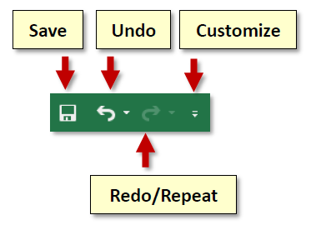

Slide 6
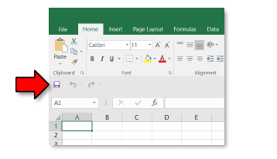
4. Click the Customize Quick Access Toolbar button again and select Show Below the Ribbon. This repositions the toolbar to be below the ribbon.

Slide 7

5. Note that when the toolbar is below the ribbon, its customize button is very difficult to see, due to its white color.
6. Move the Quick Access Toolbar back above the ribbon by clicking the customize button and selecting Show Above the Ribbon.

Slide 8
Ribbon
The ribbon contains all of the tools that you use to interact with your Microsoft Excel file. It is located at the top of the window. All of the programs in the Microsoft Office suite have one.
The ribbon has a number of tabs, each of which contains buttons, which are organized into groups. Try clicking on other tabs to view their buttons (do not click the File tab yet), and then return to Home tab.

Slide 9

Active Tab
By default, Excel will open with the Home tab active on the Ribbon. Note how the Active tab has a white background, and the Inactive tabs have the opposite.

Slide 10
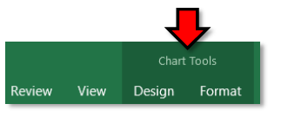
Contextual Tabs
Contextual tabs are displayed when certain objects, such as an images and charts, are selected. They contain additional options for modifying the object.
Contextual tabs stand out because they are darker in color and are located to the right of all the other tabs. As soon as we start being productive in the program, we will see contextual tabs appear.

Slide 11
Excel is a spreadsheet program from Microsoft and a component of its Office product group for business applications.
Microsoft Excel enables users to format, organize and calculate data in a spreadsheet.
By organizing data using software like Excel, data analysts and other users can make information easier to view as data is added or changed.
Excel contains a large number of boxes called cells that are ordered in rows and columns. Data is placed in these cells.

Slide 12
The core purpose of Excel all boils down to numbers. If you need to sort, retrieve, and analyze a large (or even small!) amount of data, Excel makes it a breeze.
Here are a few broad categories to keep in mind when it comes to implementing Excel for anything numbers-related.

Slide 13
Calculating

Slide 14
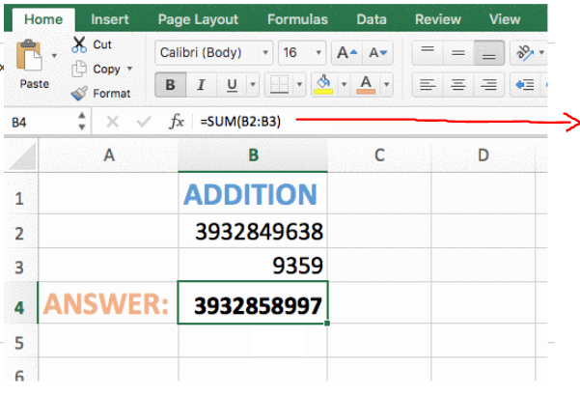
Calculating
Type this in the formula bar.
Or, type =B2+B3 and hit enter
Instead of typing the cell number (like B2, B3) you can select them by clicking or dragging with your mouse.

Slide 15
Task 1
Create a spreadsheet to multiply any two numbers together and display the result.

Slide 16
Accounting
Budget plans, forecasts, expense tracking, financial reports, loan calculators, and more. Excel was pretty much designed to meet these different accounting needs. And, considering that 89 percent of companies utilize Excel for its various accounting functions, it obviously fits the bill.
Excel even has numerous different spreadsheet templates to make all of those processes that much easier.

Slide 17
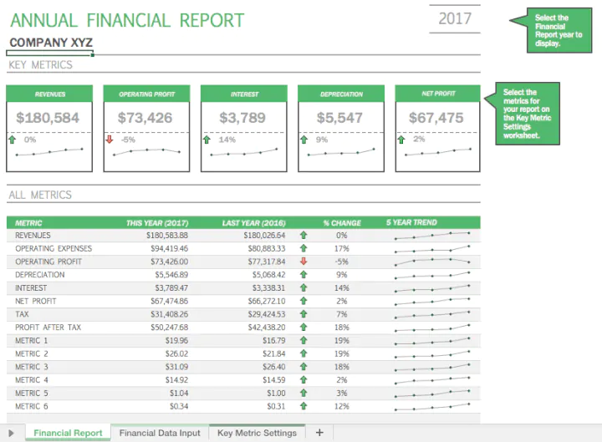
Example

Slide 18
Charting
Pie charts, scatter charts, line charts, bar charts, area charts, column charts—the list goes on and on.
If you need to find a way to represent data in a more visual and digestible way, Excel’s ability to transform rows and columns of digits into beautiful charts is sure to become one of your favorite things about it.
Want more information about the types of charts you can create in Excel? This article is a helpful resource.

Slide 19
1. Select data for the chart.
2. Select Insert > Recommended Charts.
3. Select a chart on the Recommended Charts tab, to preview the chart.

Slide 20
Note: You can select the data you want in the chart and press ALT + F1 to create a chart immediately, but it might not be the best chart for the data. If you don’t see a chart you like, select the All Charts tab to see all chart types.
4. Select a chart.
5. Select OK.

Slide 21
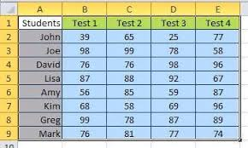
Task 2
Make a column chart from this table.

Slide 22
Making a plan
Let’s move on from the numbers—there are plenty of things that Excel can help you plan and organize that don’t necessarily involve endless rows of digits.

Slide 23
1. Add Headers to the Table
2. Add Your Project Information
3. Add Colors to Convey Project Status at a Glance
4. Create the Project Plan Timeline
5. Make the Project Timeline More Colorful

Slide 24
Task 3
Place two numbers of your choice in cells B1 and B2. Calculate in cell:
B4, the sum of the two numbers
B5, the difference between the two numbers
B6, the product of the two numbers

Slide 25
B7, the contents of cell B1 divided by the contents of cell B2
Check the calculations accuracy by comparing both the values and formulas to the images supplied. Call me over so that I can check the accuracy as well.

Slide 26
Project management charts
We’ve already touched on the fact that Excel is a total beast when it comes to creating charts. And, this concept holds true when it comes to various charts for project management.
From waterfall charts to manage your team’s progress to kanban style boards (just like Trello!) to keep things organized, there are tons of ways that Excel can help keep your project on track.

Slide 27
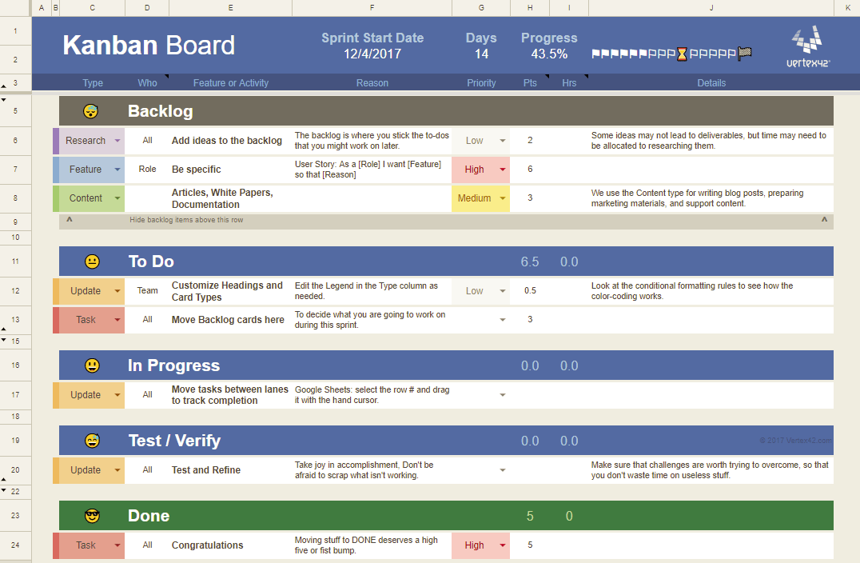
Example

Slide 28
Formula
Constant values: The values which are directly entered in the cell. They consist of text, numerals, alpha numerals, etc.
Formulas: It contains various mathematical operators, functions, etc. They perform all the calculations on Microsoft Excel data.

Slide 29
A Formula is an equation designed by a user in Excel, while a Function is a predefined calculation in the spreadsheet application.
This guide will walk you through Formula vs Function in Excel so you know exactly what the similarities and differences are.
Excel enables users to perform simple calculations such as finding totals for a row or column of numbers.
Formulas and functions can be useful in more complex situations, including calculating mortgage payments, solving engineering or math problems, and creating financial mode

Slide 30
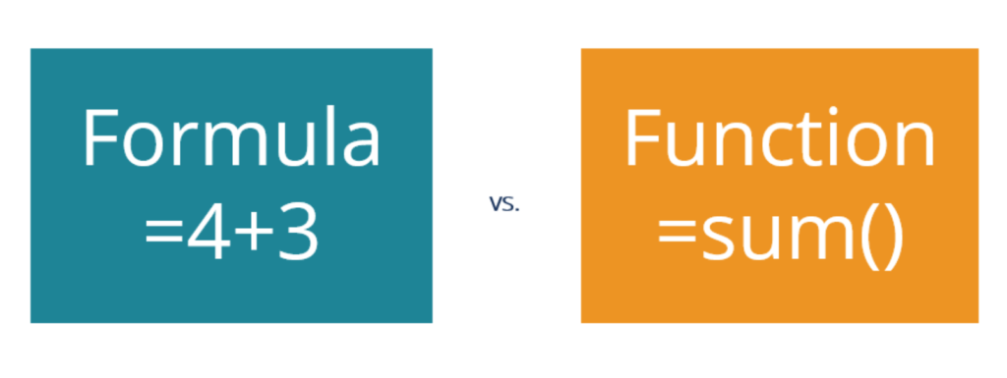

Slide 31
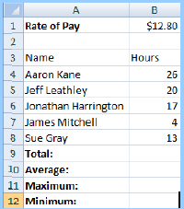
Task 4
Copy this spreadsheet model and then calculate:
The total (SUM) number of hours worked by all of these five people
The average number of hours worked per person
The maximum number of hours worked by these five people
The minimum number of hours worked by these five people.

Slide 32
Examples of a Formula
When a user types an equals sign in a cell, they are starting to create a formula.
Examples of a formula include:
=4+3
=A3+C9
=B7+B8-(4*2)+1

Slide 33
Examples of a Function
When a user types an equals sign followed by a predefined set of letters (or clicks on the Fx button in the formula bar), a function begins to be implemented.
=SUM(A3:A27)
=AVERAGE(F4:F8) [see screenshot below]

Slide 34
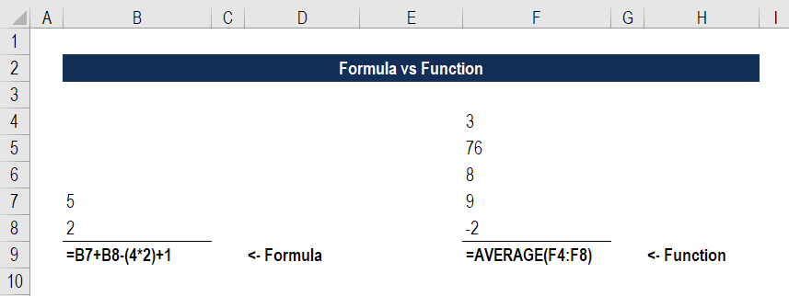

Slide 35
Examples of a Formula and Function
It doesn’t just need to be a case of formula vs function. Users can combine the two to create an even more powerful analysis.
Examples of the two combined are:
=SUM(A5:A8)/5
=AVERAGE(B3:B19)+25+SUM(1,2,3,5)

Slide 36
Formula vs Function in Practice
In common business practice, Excel users use the terms formula and function almost interchangeably.
From a communication and comprehension perspective, there’s not a big difference.
Just know that technically, a function is a piece of code that executes a predefined calculation, while a formula is something you create yourself.

Slide 37
Task 5
Aaron Kane did an extra four hours’ work. Change the spreadsheet you saved in Task 4 to show the new figures.
NOTE: The manager wants to see the average number of hours worked displayed as:
An integer value
Rounded to the nearest whole hour.

Slide 38
Task 6
Create a new spreadsheet model to calculate:
The whole number of 375.56411
375.56411 rounded to two decimal places
375.56411 rounded to the nearest whole number
375.56411 rounded to the nearest ten
375.56411 rounded to the nearest hundred
375.56411 rounded to the nearest thousand

Slide 39


Slide 40
Thank You

